Slide 1
Retail Product Sales Analysis
Faculty – M. Kiran Kumar
B. Shiva Prasad – 23241A3208
K. Ganesh – 23241A3226

Slide 2
Problem Statement:
Retail businesses generate large volumes of sales data
Manual analysis is time-consuming and inefficient
Difficult to identify trends, top products, and customer behavior
Lack of forecasting leads to poor decision-making
Impact:
Saves time in analyzing sales data
Provides real-time business insights
Helps in identifying profitable products and customers
Supports better decision-making using predictions
Objective:
To analyze retail sales data and extract meaningful insights
To support better decision-making in inventory, pricing, and marketing.
To analyze customer purchasing behavior.
To identify sales trends over time (monthly/yearly).

Slide 3
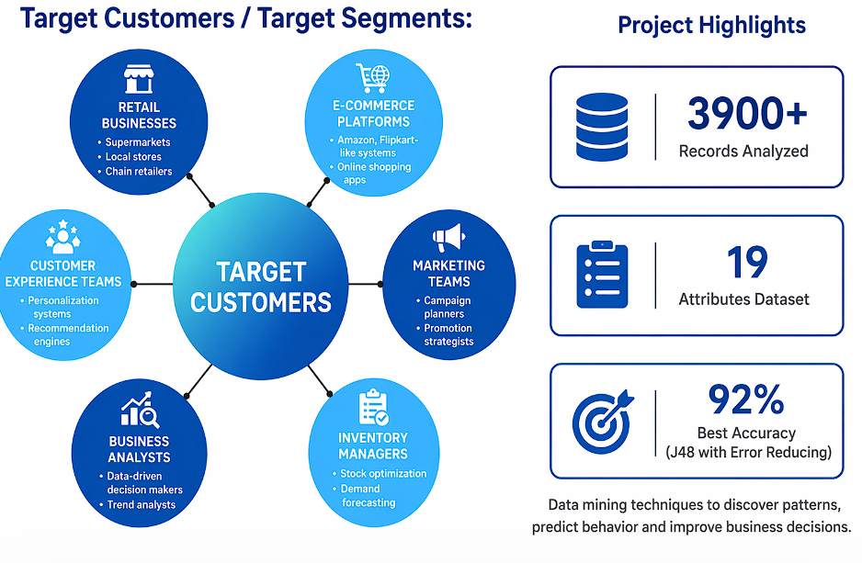
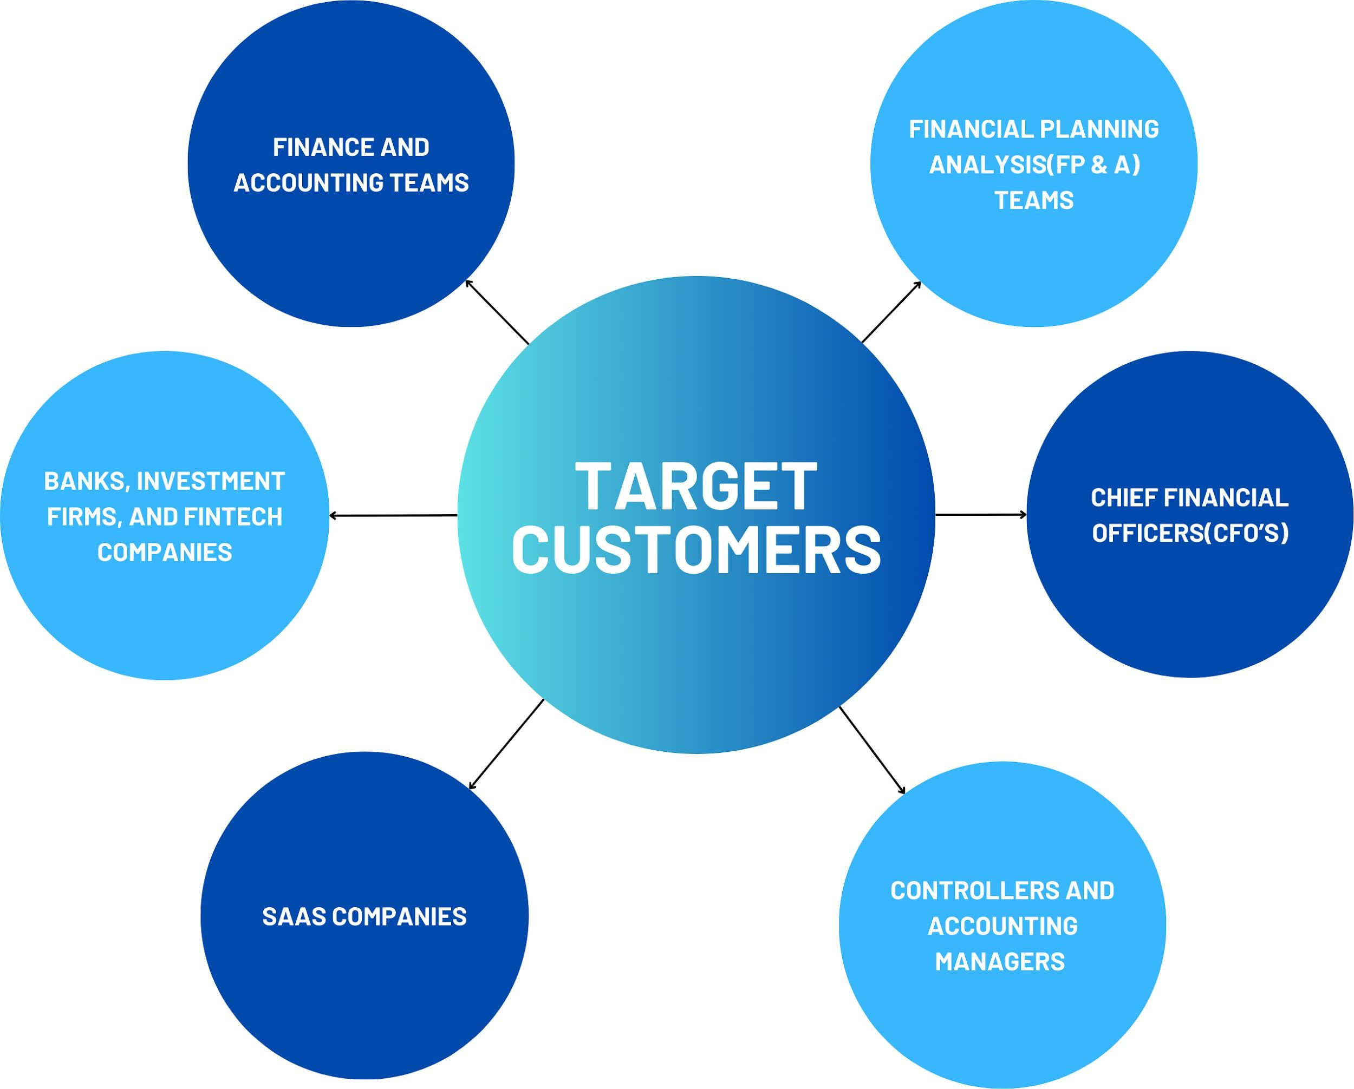
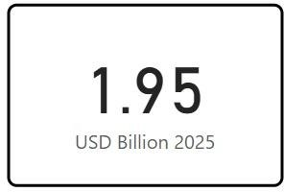
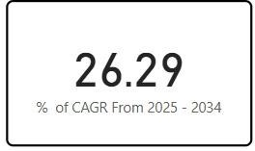
Target Segment / Market Size:
Intended Customers / Targeted Segments:
Market Size
Global Generative AI in Financial services is predicted to surpass around 15.69 USD Billion by 2034
Compound Annual Growth Rate is set to increase drastically by 2034

Slide 4
Existing Solutions / Platforms vs Finaxial AI:
Existing:
Manual Excel analysis
Limited visualization
No prediction capability
Our Solution:
Automated data processing
Interactive dashboard
Advanced visualization
Sales forecasting using ARIMA

Slide 5
Why our solution is accurate?
Data preprocessing ensures clean input
Handles missing values and inconsistencies
Uses ARIMA time-series model for prediction
Model evaluation using:
MAE
RMSE
Accuracy (MAPE-based)
Parameter tuning improves performance

Slide 6
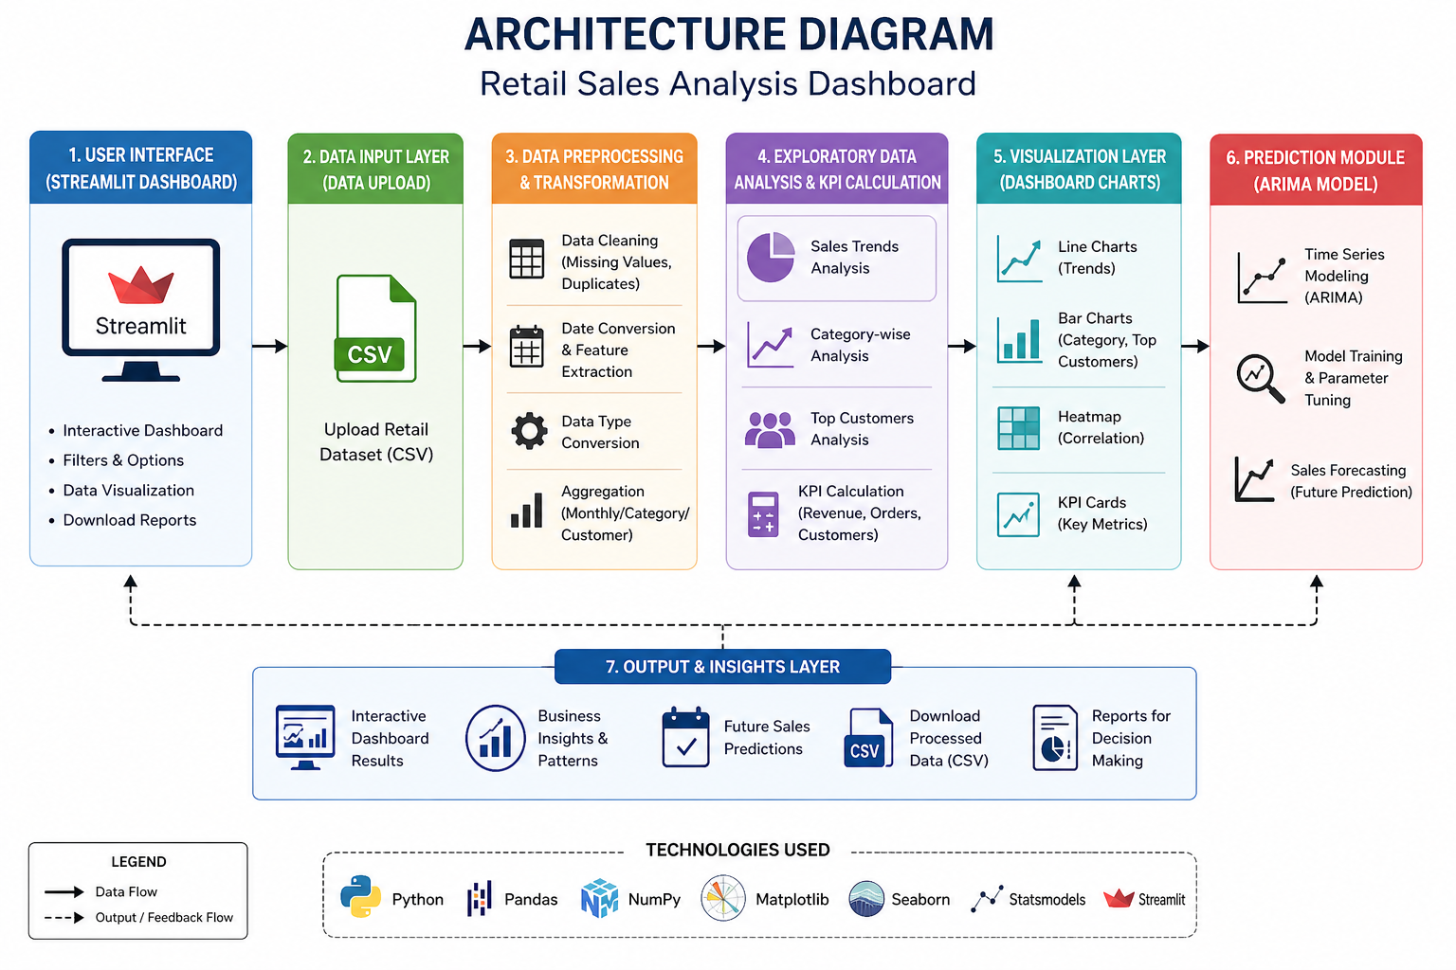
Architecture:

Slide 7
Dataset Description
At least 1–2 years of retail sales data to analyze trends and seasonal patterns. Minimum of 500–5000 transaction records to ensure meaningful analysis.
Data Types Needed:
Transaction-level data: Date, Transaction ID, Customer ID, Product Category, Quantity, Price, Total Amount.
Customer-level data: Customer ID, Gender, Age (to analyze customer behavior and segmentation).
Product-level data: Product Category, Price per unit, Quantity sold.

Slide 8
Classification Results
Accuracy: 76%
Precision: 0.84
Recall: 0.83
F1-score: 0.83

Slide 9
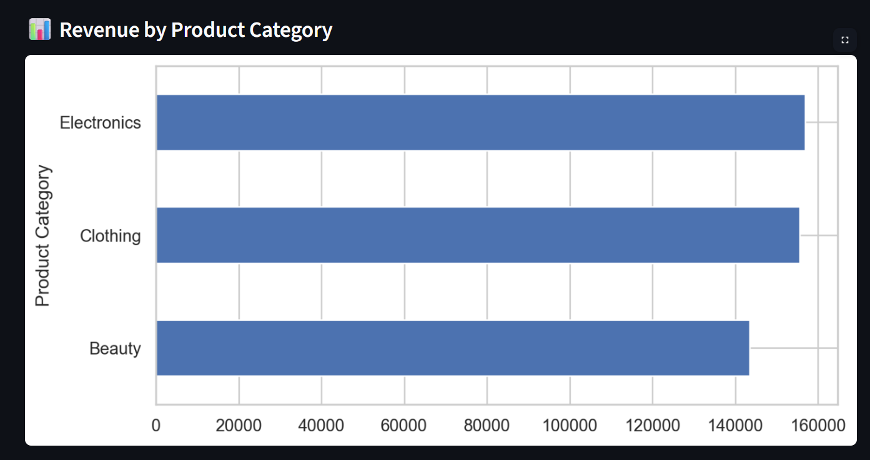
Results

Slide 10
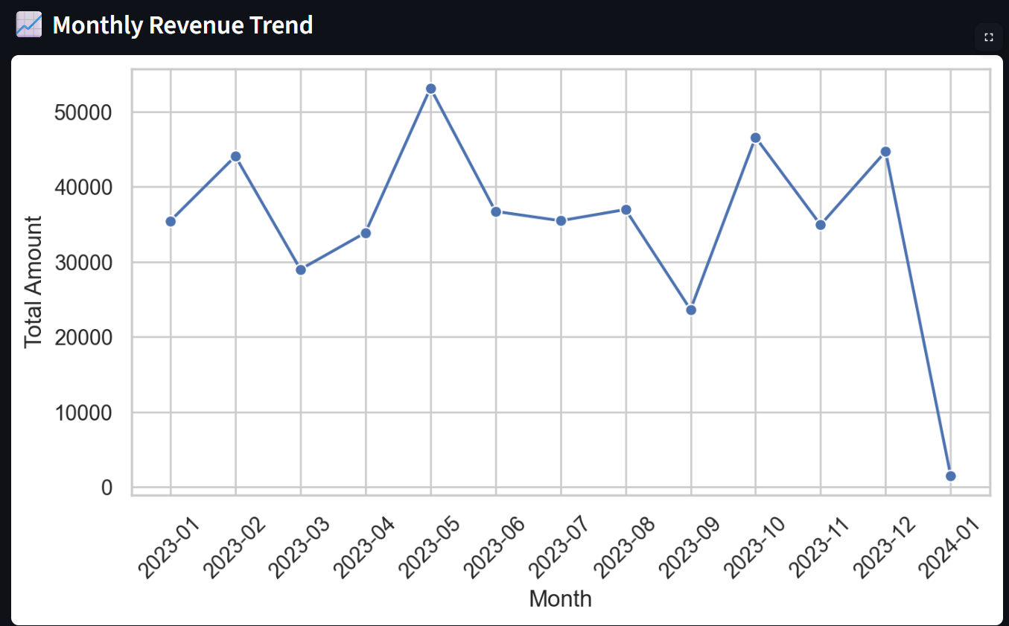
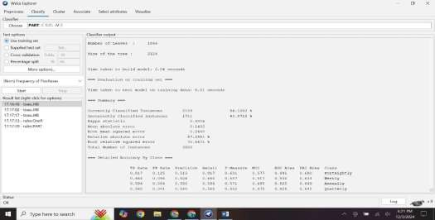
J48 Unpruned Tree

Slide 11
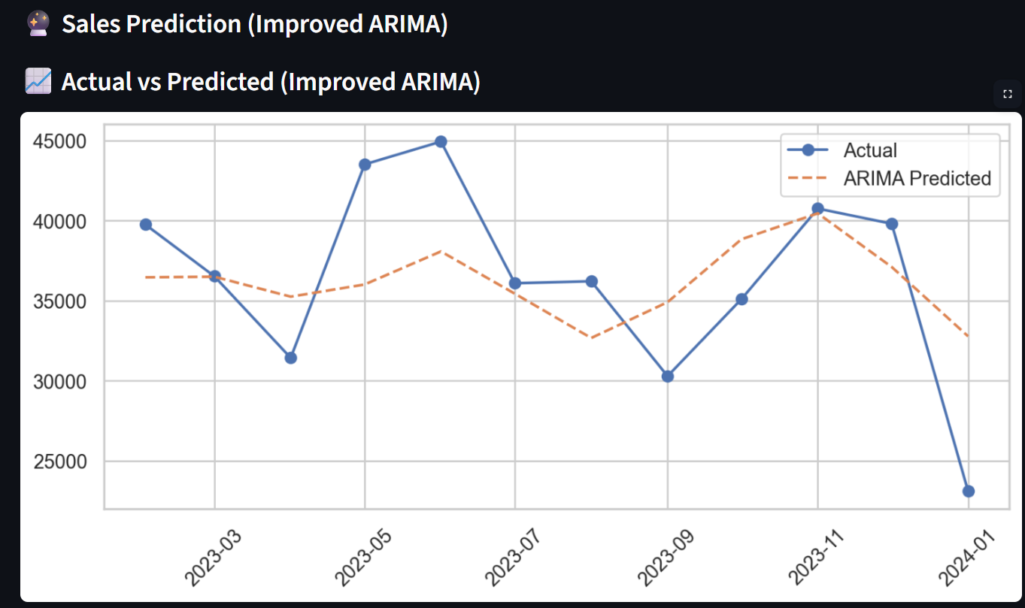
PART

Slide 12
Conclusion:
What it is:
A data-driven dashboard for retail sales analysis
Key Features:
Interactive dashboard
Dynamic filtering
Data visualization
Sales forecasting
Benefits:
Improves decision-making
Reduces manual effort
Provides business insights

Slide 13
Future Enhancements:
Real-time data integration
Advanced models (Prophet, ML models)
Customer segmentation
Online deployment with live dashboard
Mobile-friendly interface

Slide 14

Thank You

